Slide 1



Virtual Pet Simulator

Slide 2
Small Audience
Individuals with allergies or space constraints
Busy professionals or students
Prospective Pet owners

Slide 3
High Impact
Emotional Satisfaction
Flexibility and Convenience
Introduction to Pet cair

Slide 4
User Stories and Prioritisation
Acted in accordance with first sprint plan
Pet creation
Basic pet interaction
User account authentication
Basic UI
Must have user stories
Story ID 1: Create new pet
Story ID 2: customise a pet
Story ID 5: Add new pet to collection
Story ID 9: Feed a pet
Story ID 10: clean a pet
Story ID 16: Account Registration/Login/Logout
Story ID 17: Account Authentication (By Password)
Story ID 18: Saving user’s progress

Slide 5
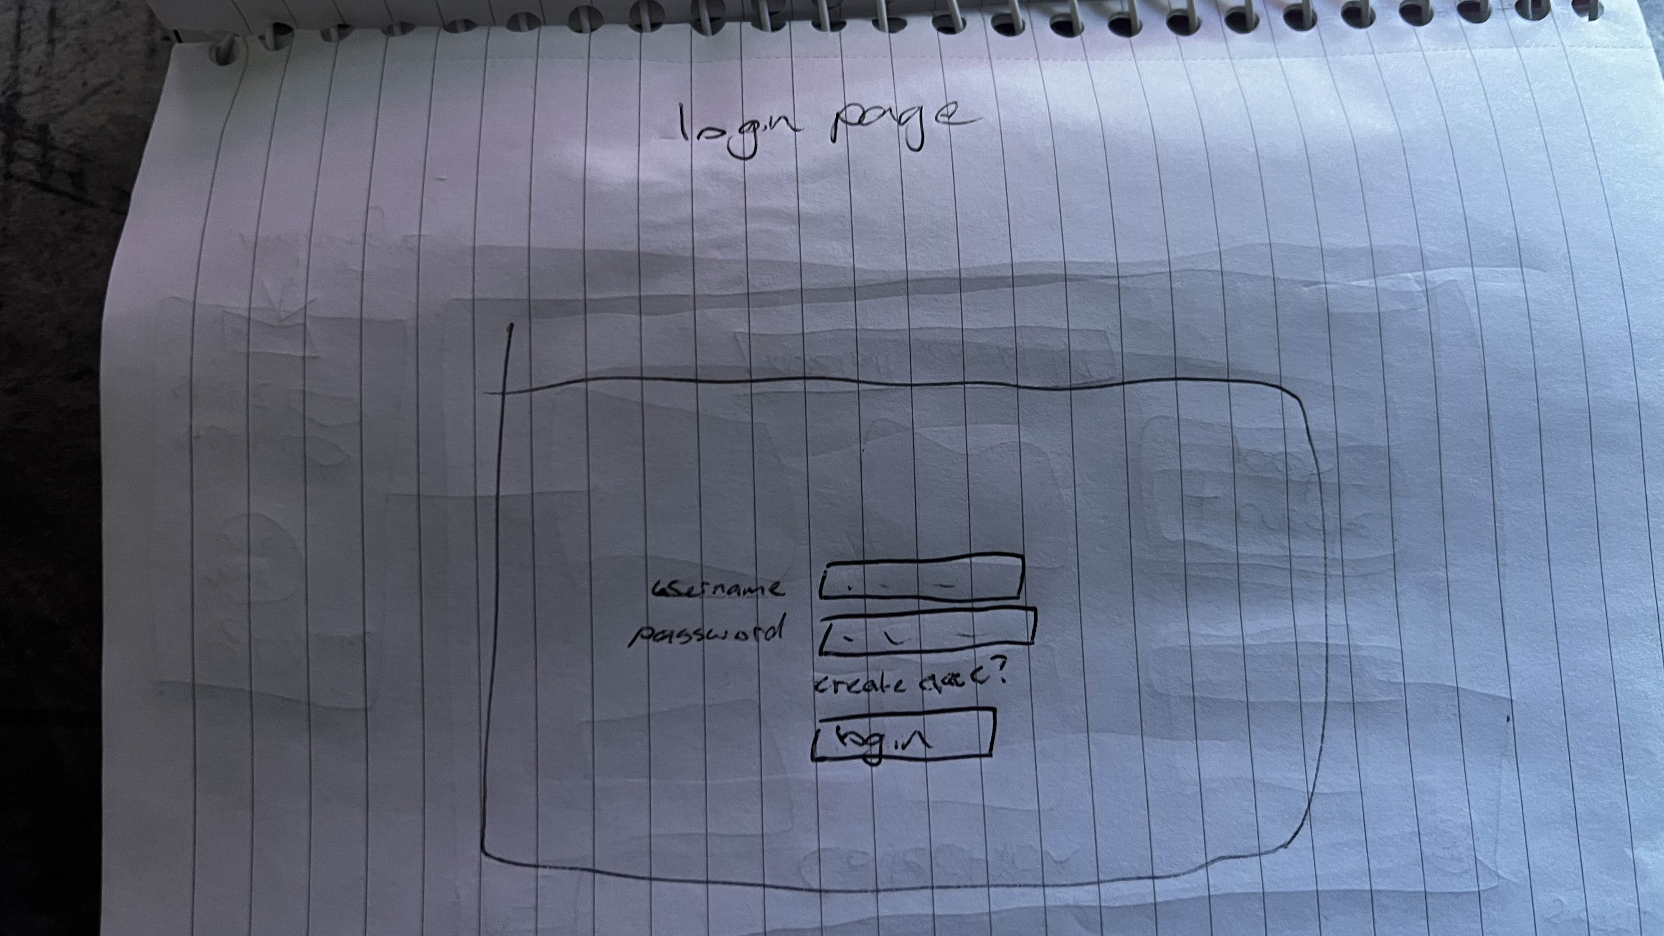
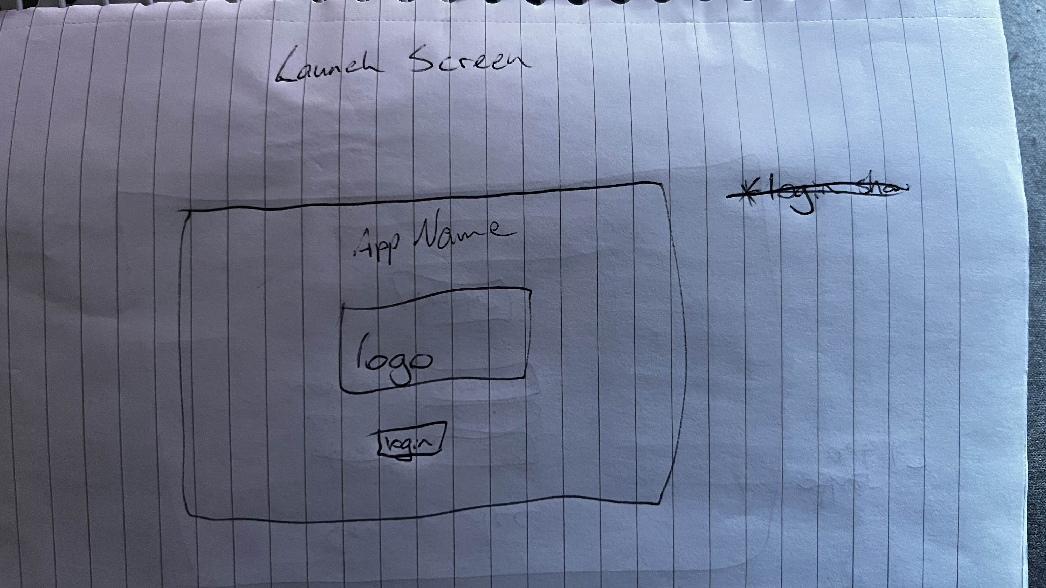
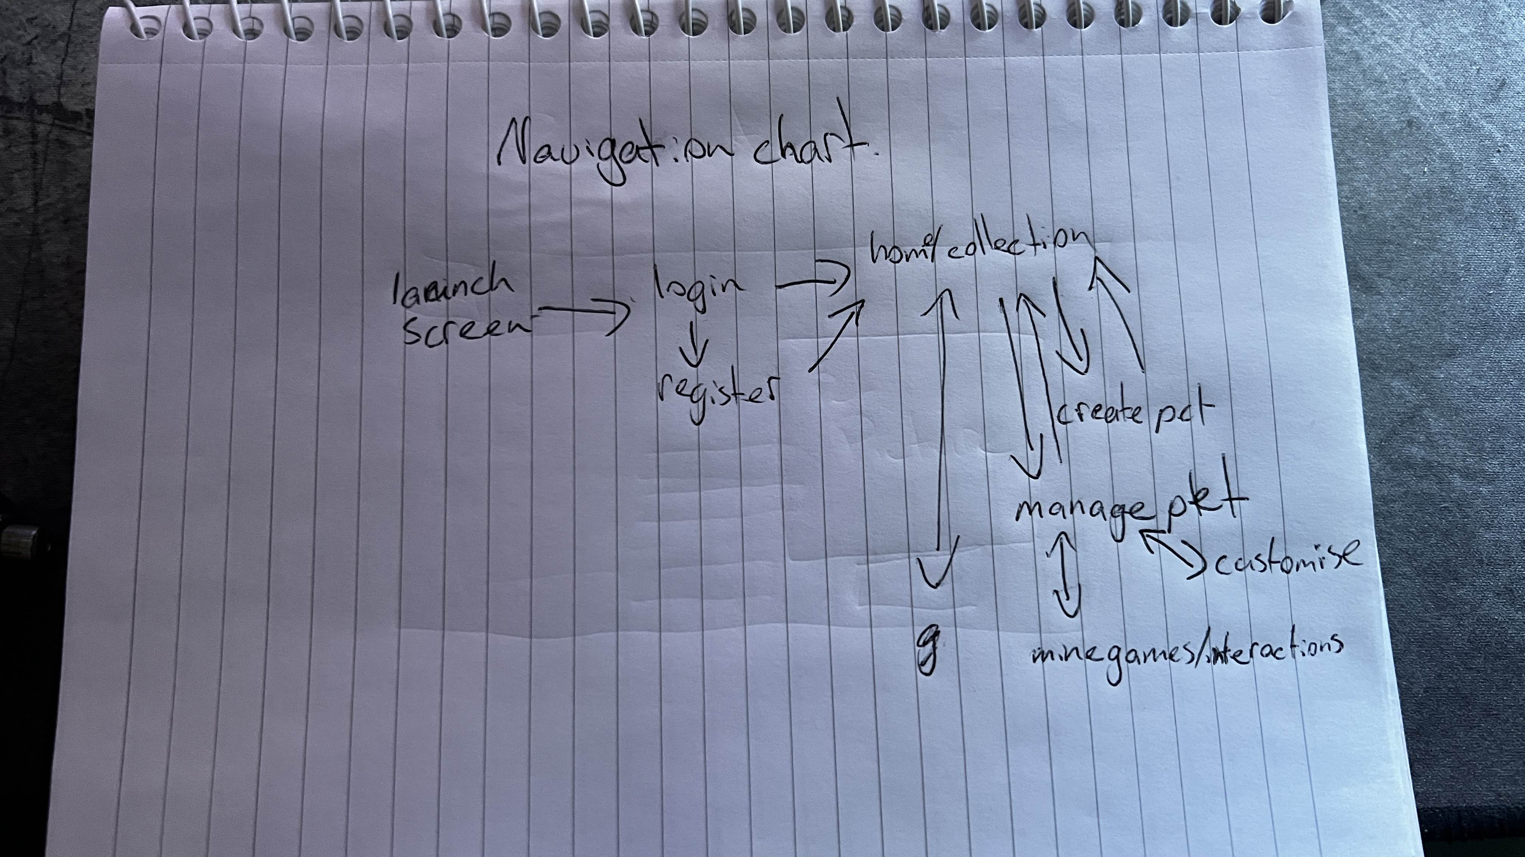
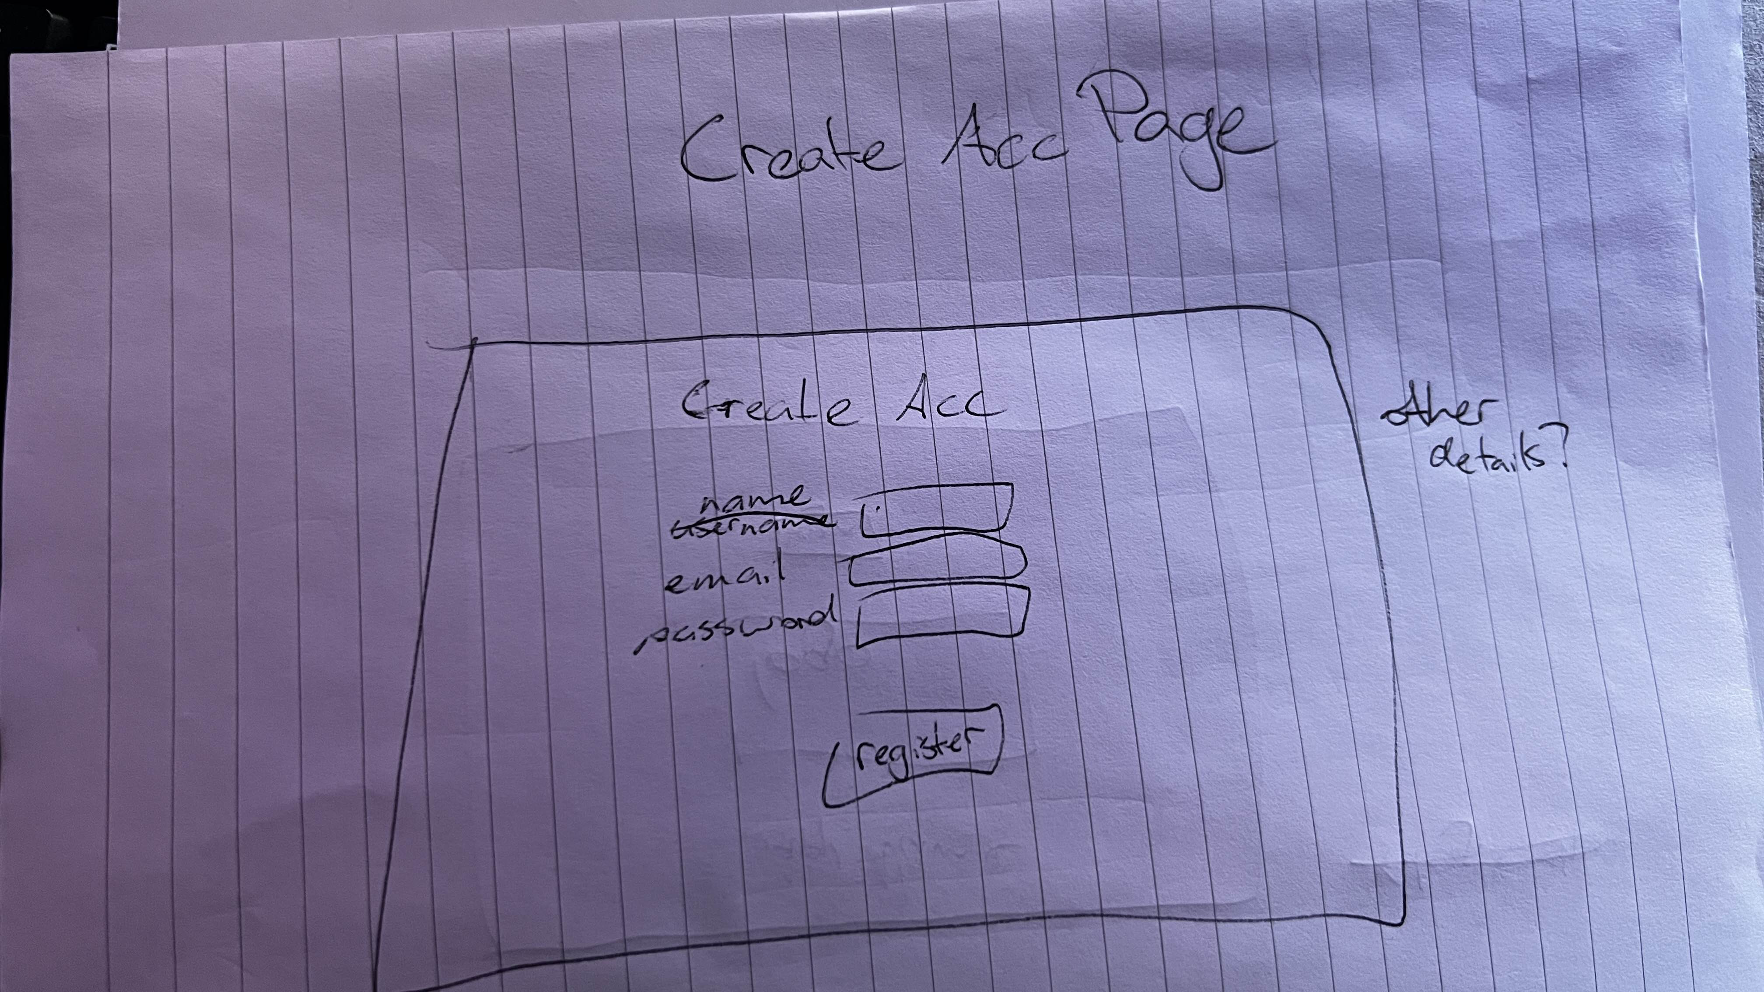
Low fidelity

Slide 6
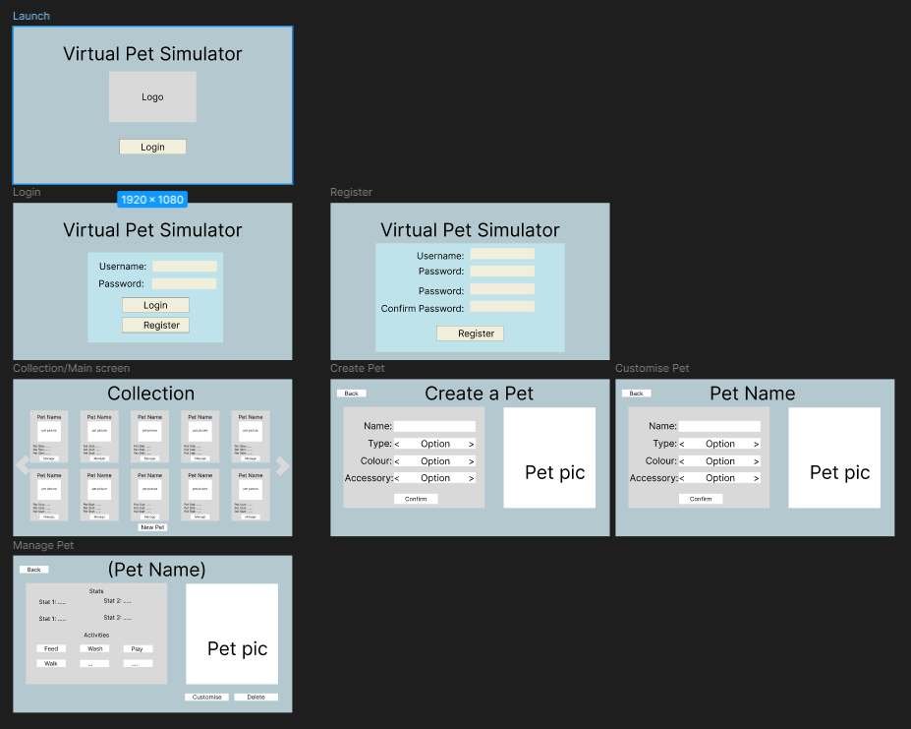
Medium Fidelity

Slide 7
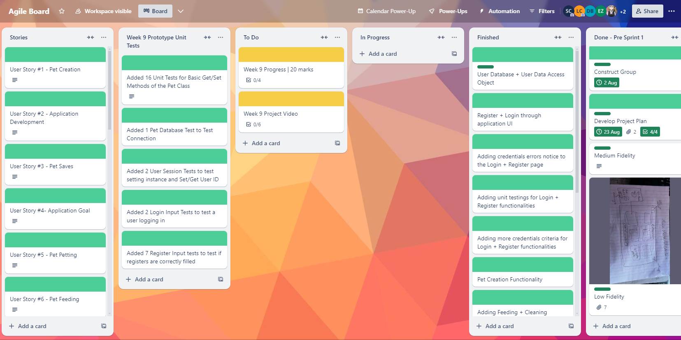
Project Management Tool
https://trello.com/b/7k3iZmGE

Slide 8
Github Usage
Each person making any major changes utilised branches so as to maintain functional versions of code.
Code was regularly merged to reduce conflicts
Advance communication between team members to reduce conflicts

Slide 9
JavaFX Code Summary
Follows Model-View-Controller pattern
with controllers managing FXML-based views
Core screens:
Launch view, login view, register view, collection view, pet creation view, pet interaction view, other+
Design & Styling
Consistent color scheme, modern UI elements, visual effects for buttons and grids
Navigation:
Scene transitions using FXMLLoader for seamless UI flow

Slide 10
Database persistence code summary
General Approach
User management
Pet Management
Separation of concerns
Separation between data access (DAO), business logic (managers), and database connection handling
Secure operations
Prepared statements for secure database queries, preventing SQL injection attacks
Design Patterns
Singleton design pattern for managing database connections, controlled access to database resources
User database persistence:
User data is stored in SQLite database
Data Access Layer
Implements CRUD operations
Authentication and verification
Singleton Database Connection
Ensures singleton connection instance for efficient resource usage
Pet data persistence:
Pet data stored in SQLite database
Advanced data operations
Provides CRUD operations
Data Access Layer
Uses interface-driven approach to separate data operations from business logic, ensuring modularity and flexibility.

Slide 11
Unit tests code summary
Setup
Use @BeforeEach for initialising common components before each test
Validation
Check for field completeness, input correctness, and existing entries
Assertions
Use assertions to confirm expected behaviour, like assertTrue and assertFalse
Database Interaction
Test adding, checking, and deleting data to validate the database functionality
Input scenarios
Verify behaviour for valid and invalid inputs, matching passwords, and readiness of inputs

Slide 12
Code demonstration

